Slide 1
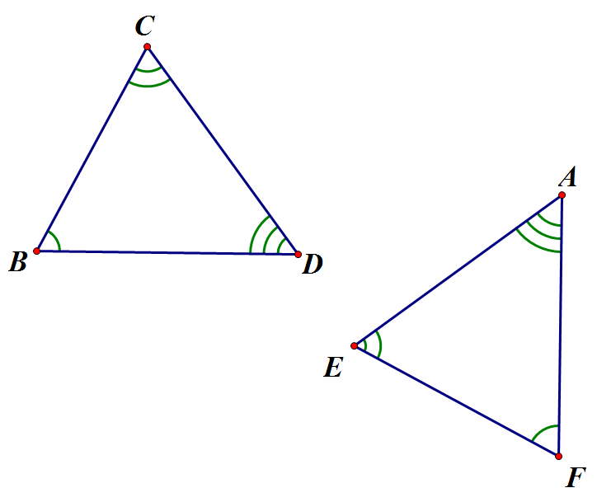
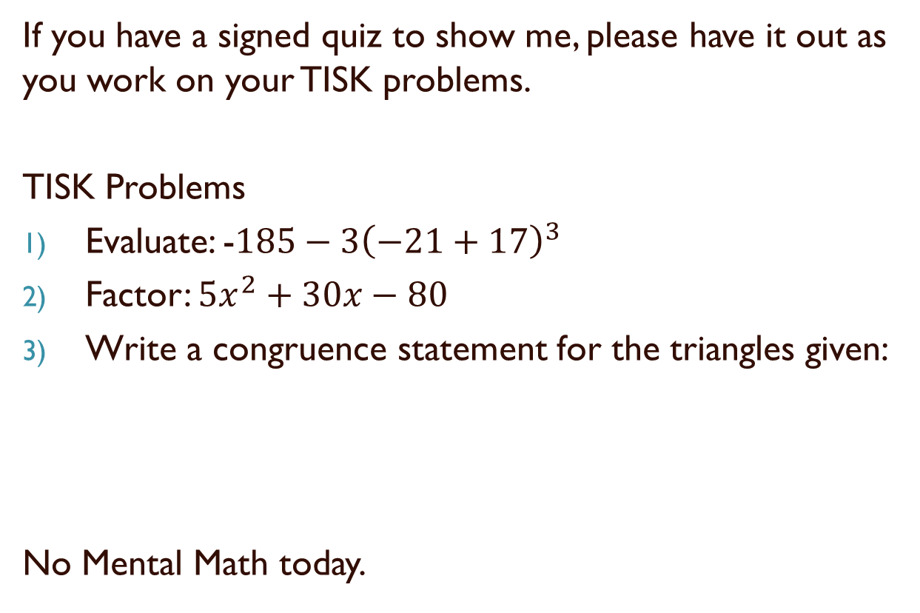
Wednesday, October 31, 2012
If you have a signed quiz to show me, please have it out as you work on your TISK problems.
TISK Problems
Evaluate: -$185−3{\left(−21+17\right)}^{3}$
Factor: $5x^{2}+30x−80$
Write a congruence statement for the triangles given:
No Mental Math today.

Slide 2
§5-1 Special Segments in Triangles
Perpendicular Bisectors
  Def.: A segment is a perpendicular bisector of a triangle iff it passes through the midpoint of the segment and is perpendicular to the segment.
  Theorem: A point is on the perpendicular bisector of a segment if and only if it is equidistant from the endpoints of the segment.

Slide 3
§5-1 Special Segments in Triangles
Median
  Def.: A segment is a median of a triangle iff its endpoints are a vertex and a midpoint of the side opposite that vertex.

Slide 4
§5-1 Special Segments in Triangles
Altitude
  Def.: A segment is an altitude of a triangle if and only if one of its endpoints is a vertex of the triangle and the segment is perpendicular to the side opposite that vertex.

Slide 5
§5-1 Special Segments in Triangles
Angle Bisector
  Def.: A line, segment or ray is an angle bisector if and only if it divides an angle into two congruent angles.
  Theorem: A point is on the bisector of an angle if and only if it is equidistant from the sides of the angle.

Slide 6
Homework
p. 243 #24-27, 28-31 & 34

